Slide 1
Vortex Micro Architecture
Presenter: Blaise Tine
Notes:
Narration:
This poster presents Vortex, a reconfigurable and scalable RISC-V GPGPU accelerator.
Vortex’s main goal is to use RISC-V to utilize the advantages of SIMT execution model and provide a customizable design to facilitate architecture research.
In addition, we show that a minimal set of 5 instructions is enough to achieve a highly parallel execution model on RISC-V.
Single Instruction Multiple Threads execution model, or SIMT, has the advantage of having a scalar based programming model, which makes it easier to program on.
Through POCL, an open-source framework to implement the compiler and runtime software for OpenCL, we were able to execute unmodified OpenCL kernels on Vortex.
We achieved that by linking POCL with Vortex's runtime kernel, which provides warp and thread creation, warp barriers, and control divergence.
Vortex microarchitecture has two main configuration methods to scale for various application domains: increasing the number of parallel work-items and configuring the cache system. Each one of these methods has its own unique trade-offs, both in terms of performance for different applications and hardware and energy cost. The first method is to increase the parallel work-items in the design by either increasing the number of threads per warp, number of warps per core, number of cores per clusters, and the number of clusters. The second method is by configuring the cache system. Our L1, shared memory, L2, and L3 are all based on the same high-throughput banked design that supports a snoop protocol and prefetching.
We have evaluated our design both 15 nm educational library and Arria 10 Intel FPGA on a subset of Rhodina benchmarks and were able to achieve frequencies of 300 MHz and 192 MHz respectively.
In addition, we were able to fit a 2 cluster 8 core configuration with a total of 256 work units on Arria 10 Intel FPGA.
We also used the OPAE open-source accelerator API to be able to execute OpenCL kernels on the FPGA.

Slide 2
Agenda
ISA Extension
GPGPU Microarchitecture
High-Bandwidth Caches
Texture Units

Slide 3
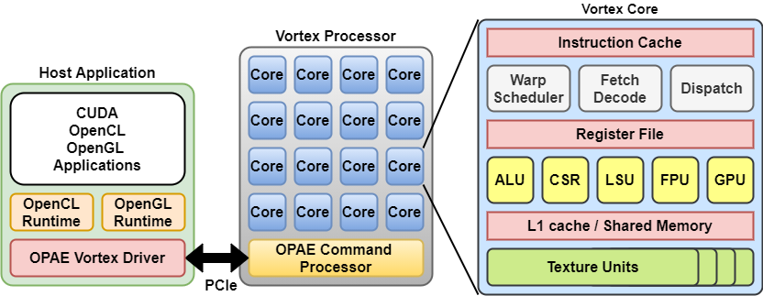
Vortex GPGPU Platform
Hardware
Fully configurable multi-core GPU
PCIe host-device interface
Up to 32-cores @ 200 MHz
Caches & shared Memory
Floating-point Units
Hardware texture units
Open-source toolchain
POCL: OpenCL
SwiftShader : OpenGL
OPAE: FPGA Driver API
Verilator: RTL simulation
Yosys: FPGA Synthesis

Slide 4
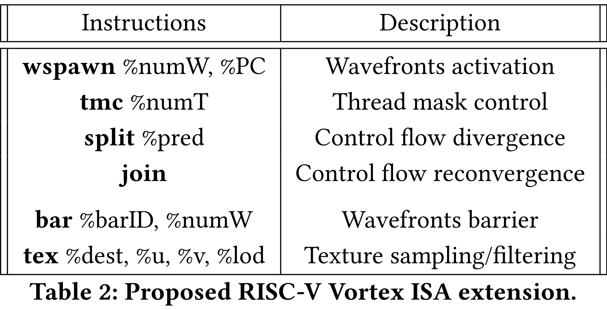
RISC-V ISA Extension for Vortex
Threading model
Wavefronts
Threads
Memory model
Global memory
Shared memory
Register File
Use RISC-V Int/float registers
No predication
Synchronization
Use RISC-V fence

Slide 5
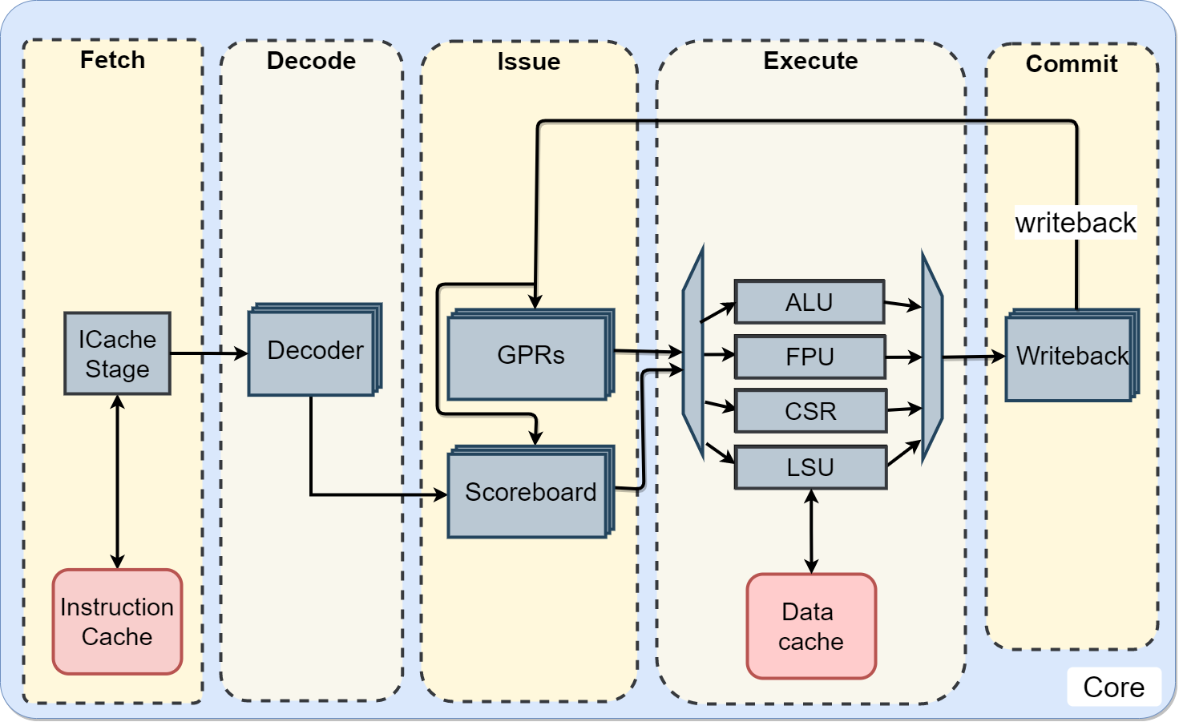
Vortex GPU Microarchitecture
Five-stage RISC-V Pipeline
IF | ID | Issue | EX | Commit
In-order issue / out-of-order commit
Single-precision FPU

Slide 6
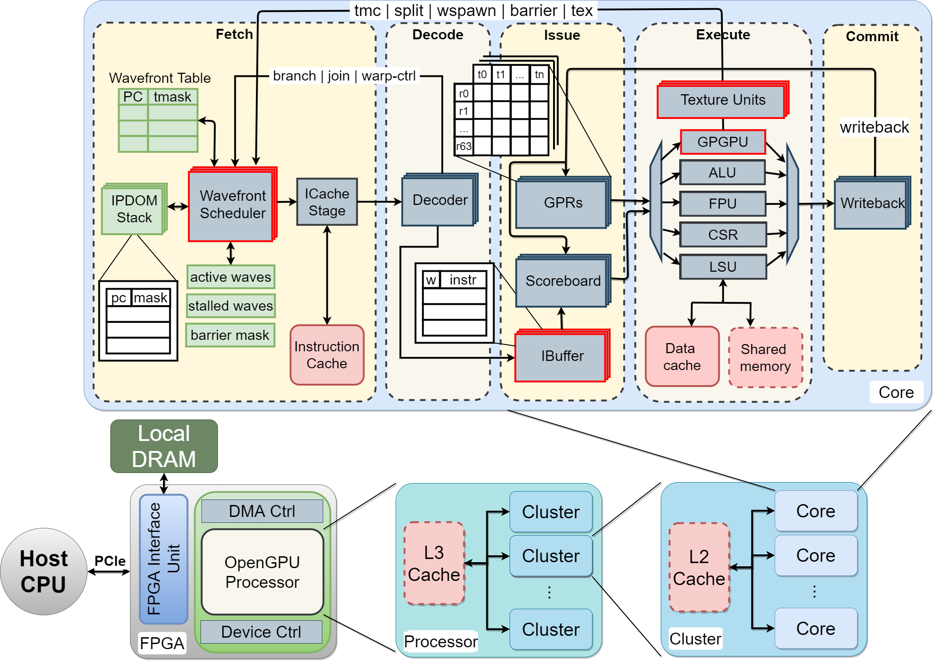
Vortex GPU Microarchitecture (2)
Five-stage RISC-V Pipeline
IF | ID | Issue | EX | Commit
In-order issue / out-of-order commit
Single-precision FPU
Wavefront Scheduler
Instruction Buffer
GPGPU Execute Unit
Shared Memory
Texture Units

Slide 7
Vortex GPU Microarchitecture (3)
Clustering
Processor
[cluster*] [L3 cache]
[core*] [L2 cache]

Slide 8
Vortex GPU Microarchitecture (4)
AFU Command Processor
Local DRAM access
Host CPU-GPU communication
Data transfer
GPU control & status

Slide 9
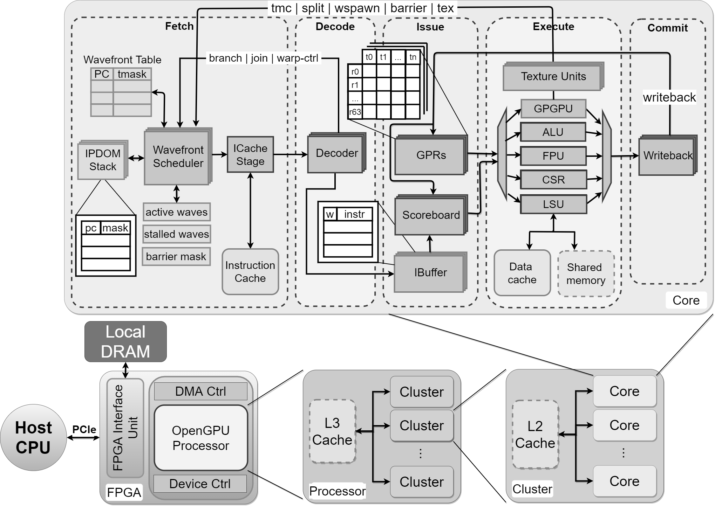
Vortex GPU Microarchitecture (5)
Fetch
Issue ICache request
(PC, wid, tmask)
Decode
Decode instruction into Ibuffer
(instr, wid, tmask)
Issue
Issue instruction to execute unit
(instr, regs, wid, tmask)
Writeback
Write result into GPRs
(result, wid, tmask)
instr
regs wid tmask
PC wid tmask
result
wid
tmask
instr
wid
tmask

Slide 10
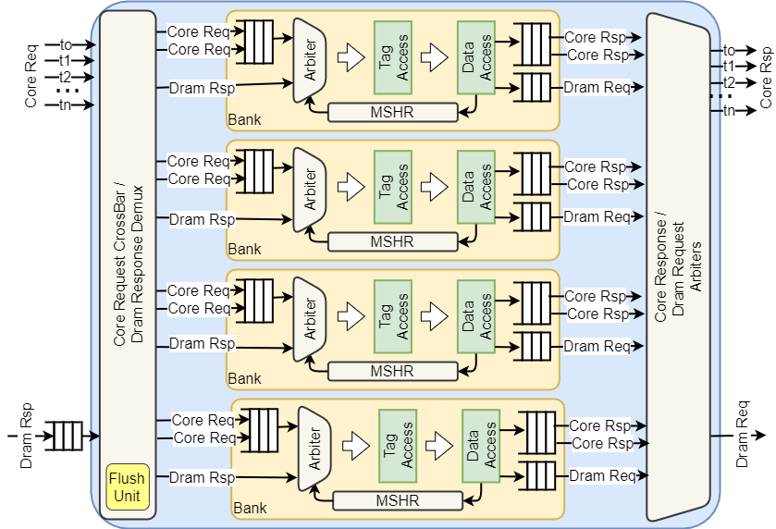
Vortex High-bandwidth Caches
Design goals
High-bandwidth transactions
Non-blocking operation
Highly Configurable
Challenges
Handling bank conflicts
FPGA constraints
SRAM ports
Area cost

Slide 11
Vortex High-bandwidth Caches (2)
Reducing bank conflicts on GPU
Coalescing aligned memory addresses
Takes place inside the LSU
Design shortcomings for Vortex
LSU and Cache Intra-dependency
LSU overhead
Cache request overhead
Shared memory doesn’t need coalescing
Unnecessary delay cycle
L2/L3 caches also have bank conflicts
11

Slide 12
Vortex High-bandwidth Caches (3)
Our solution: Virtual multi-porting
Perform coalescing inside the cache
How?
Add virtual ports to each bank
Ports hold requests to same line
Advantages
No cycle overhead
Added to the bank select logic
Maximize cache line read access
Minimal storage overhead in MSHR
Reuse exiting SRAM port
Configurable number ports
Area vs Perf.
Bank
Conflict!
Pipeline Register
Pipeline Register
Pipeline Register
CL1
ARB
Tag Access
Data Access
AddrA
CL2
ARB
Tag Access
Data Access
AddrB
CL3
ARB
Tag Access
Data Access
AddrC
CL3
ARB
Tag Access
Data Access
AddrD
Bank select
And
Coalescing
Core
Response
Merge

Slide 13

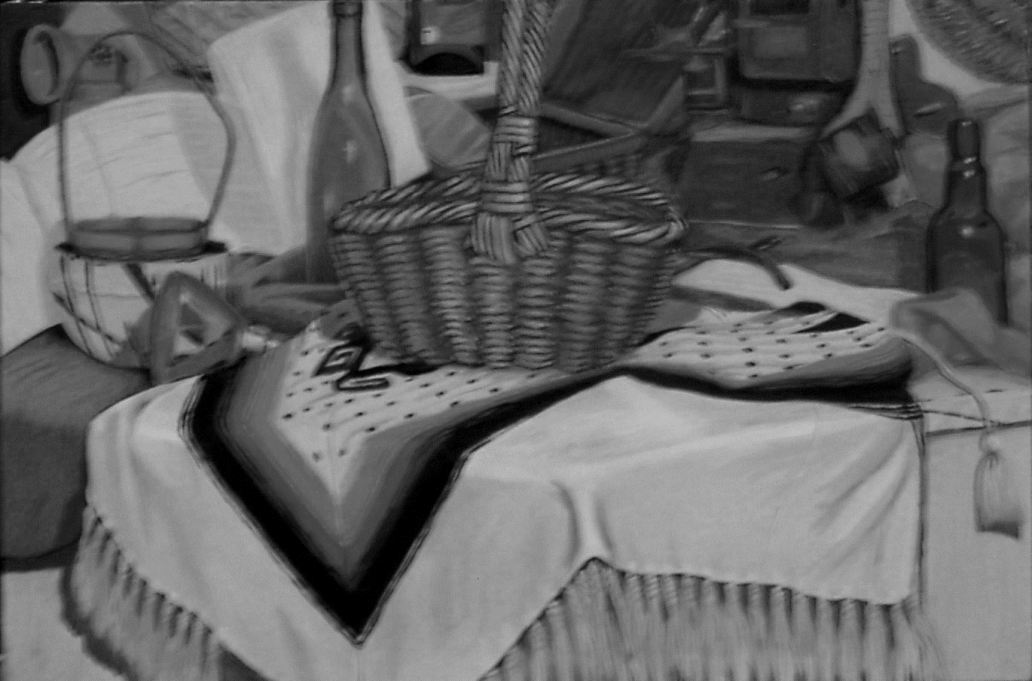
Vortex Texture Units
Motivation
Accelerating texture filtering
Application
Image processing: OpenVX, OpenCL
2D,3D graphics: OpenVG, OpenGL
Texture filtering complexity
Memory bound
Quad texels fetch
Mipmapping
Compute bound
Texture sampling
linear, bilinear, trilinear
Vortex Rendering
Kernel
Texture Sampling
13
13
13

Slide 14
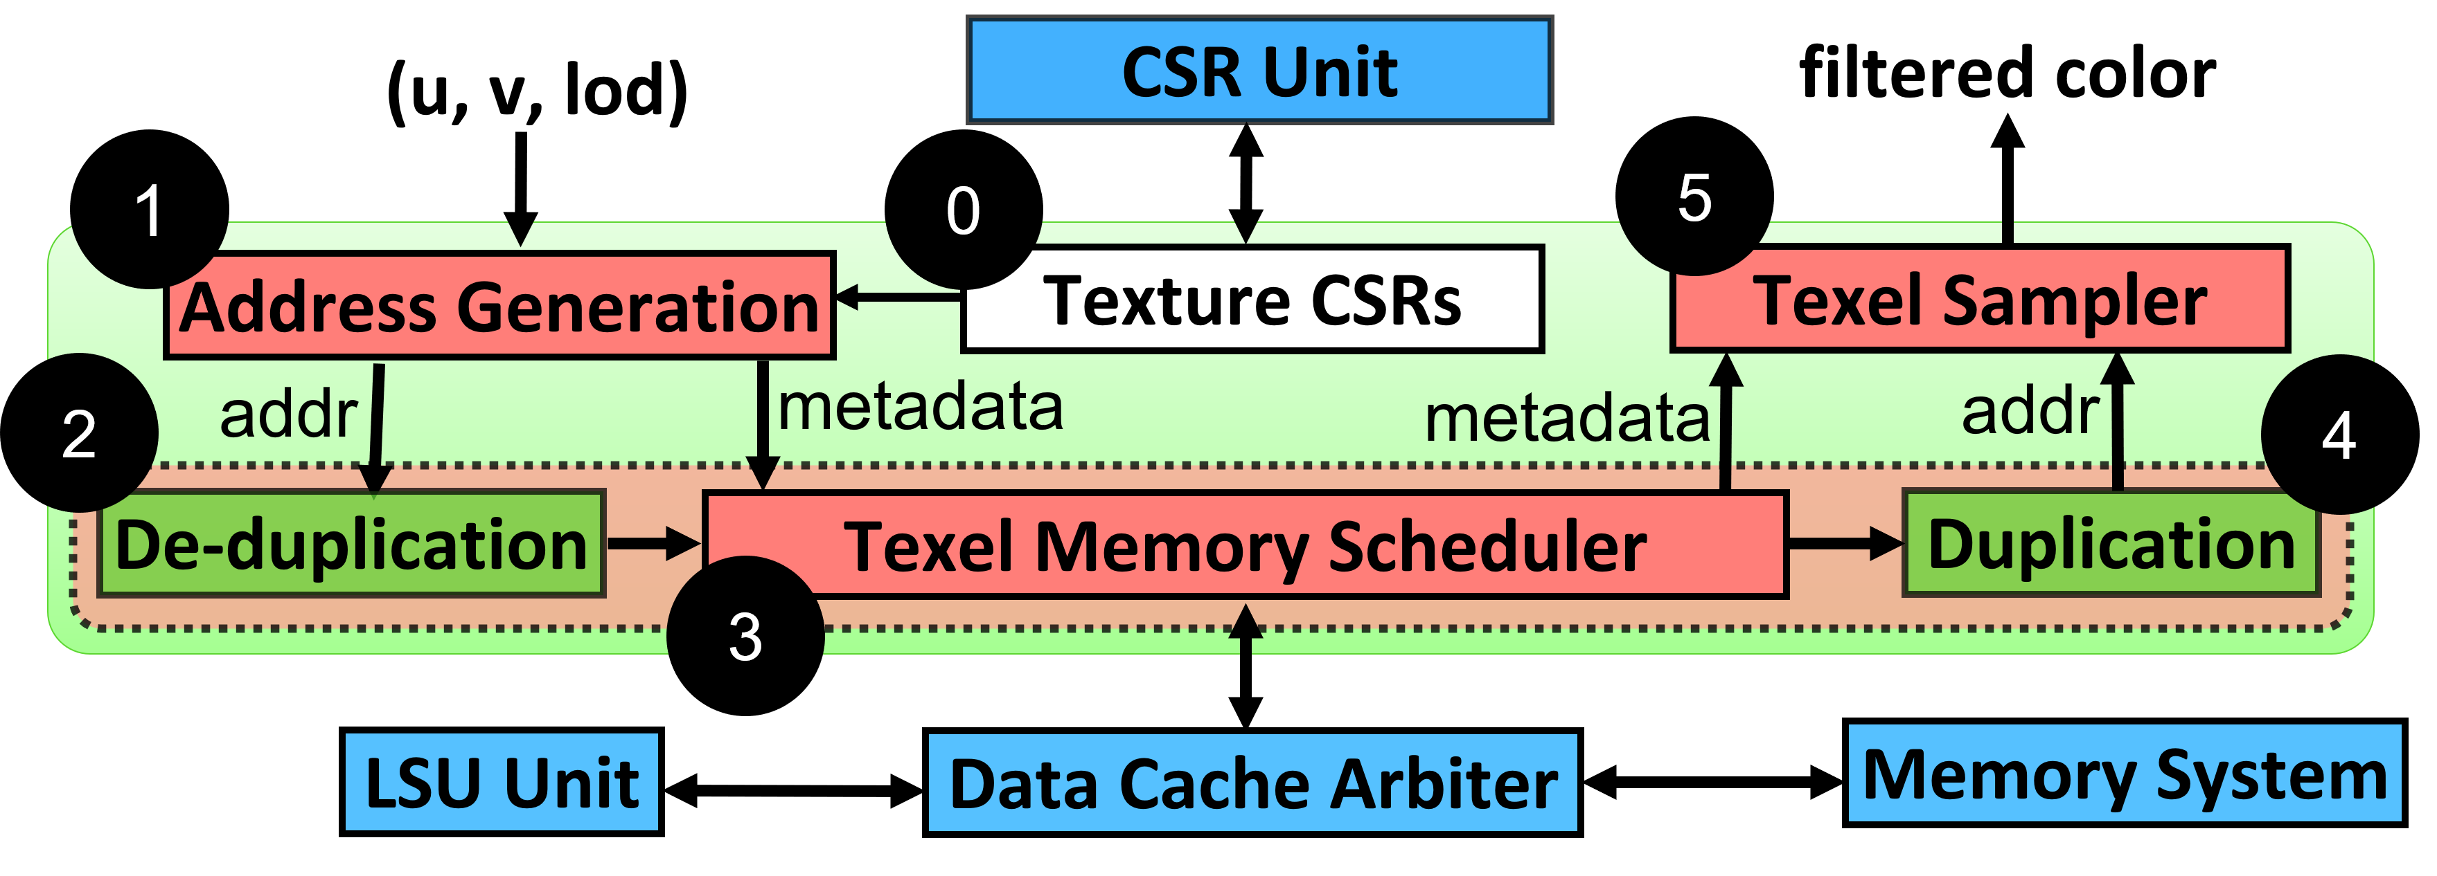
Vortex Texture Units (2)
Texture unit configuration
Use RISC-V unused CSRs
Store per-miplevel texture info
Dimensions and format
Addressing mode
Filtering mode

Slide 15
Vortex Texture Units (3)
Address Generation
Calculate texture addresses
Apply Addressing mode
Memory Scheduler
Detect duplicate addresses
Schedule memory requests
Gather texel results
Texel Sampler
Decode texture format
Apply texture sampling

Slide 16
Thank You!

